Slide 1
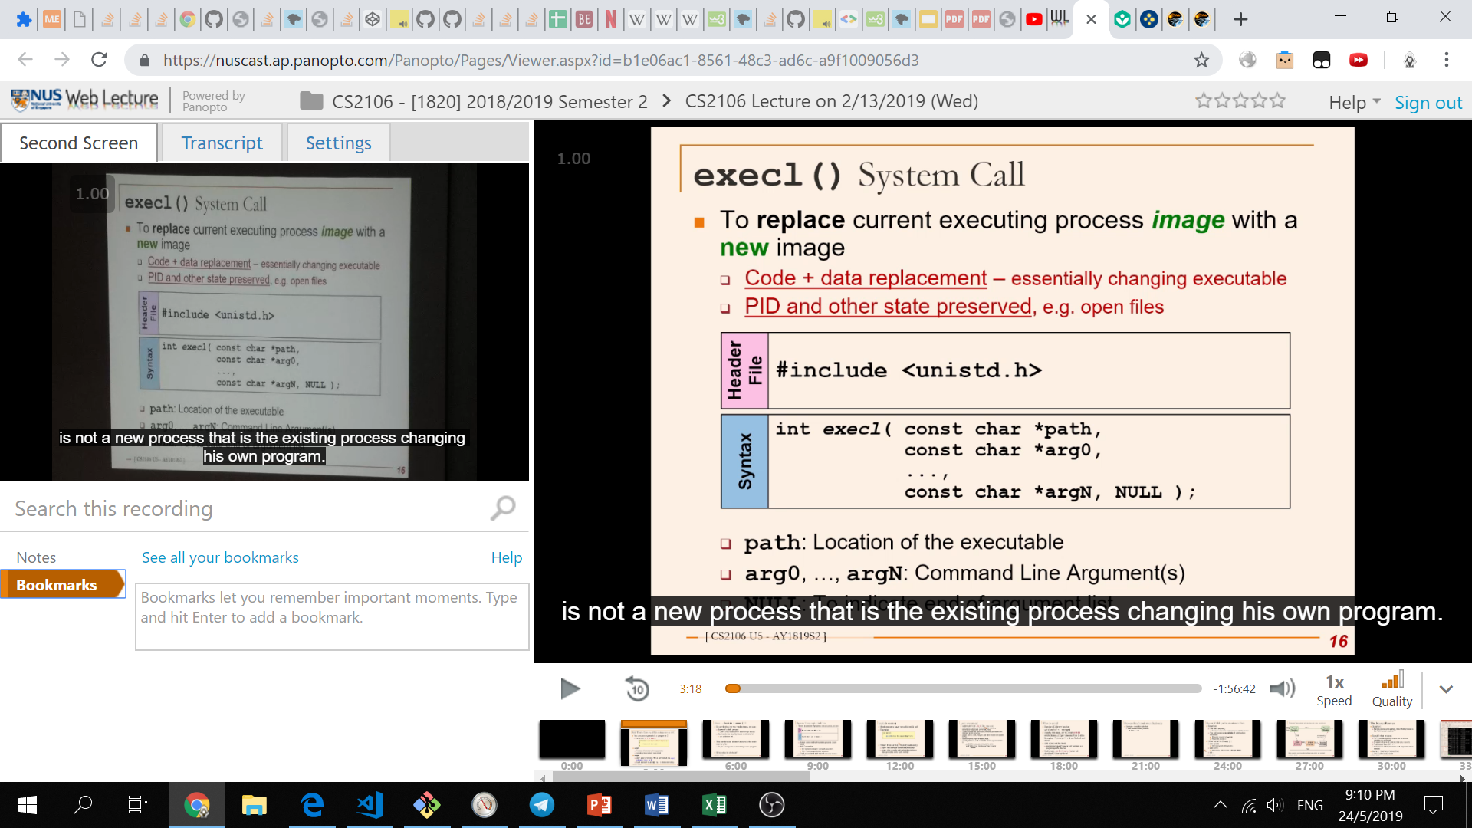
Panopto Plus
Chrome extension to improve the user experience of webcasting
Key Features:
Improved user interface
Faster playback speed options, persistent user settings etc
Subtitles & Transcript
Auto removal of silent sections in the webcast
Group 1: Matthew Lee & Fyonn Oh

